Slide 1
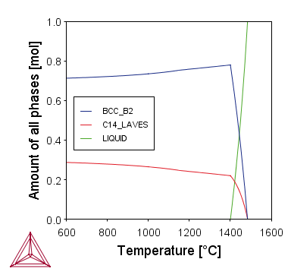
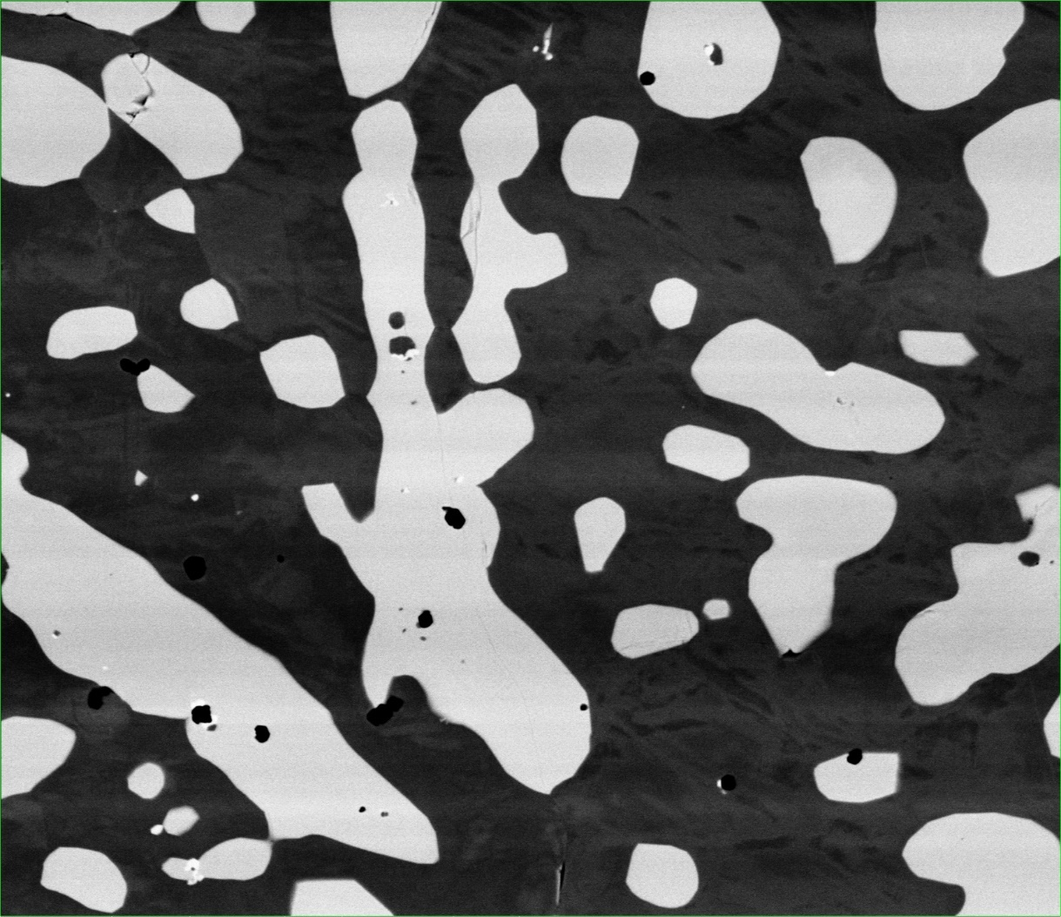
50 μm
Figure 1. LM1 Thermo-Calc simulation comparison to BSE image
Table 1. LM1 Phase Compositions at 1200 °C
 | Phase | Al | Cr | Mn | Fe | Nb
Thermo-Calc | BCC B2 | 36.8 | 14.6 | 12.8 | 33.2 | 2.6
 | C14 Laves | 29.3 | 16.3 | 1.2 | 20.1 | 33.1
EDX Measured | Matrix | 48.4 | 15.0 | 8.9 | 26.8 | 0.8
 | Particle | 33.6 | 7.5 | 5.0 | 25.7 | 28.1

Slide 2
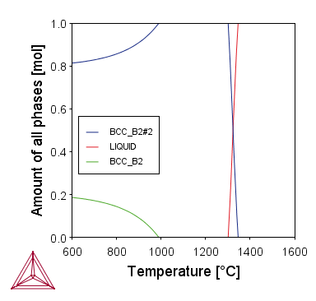
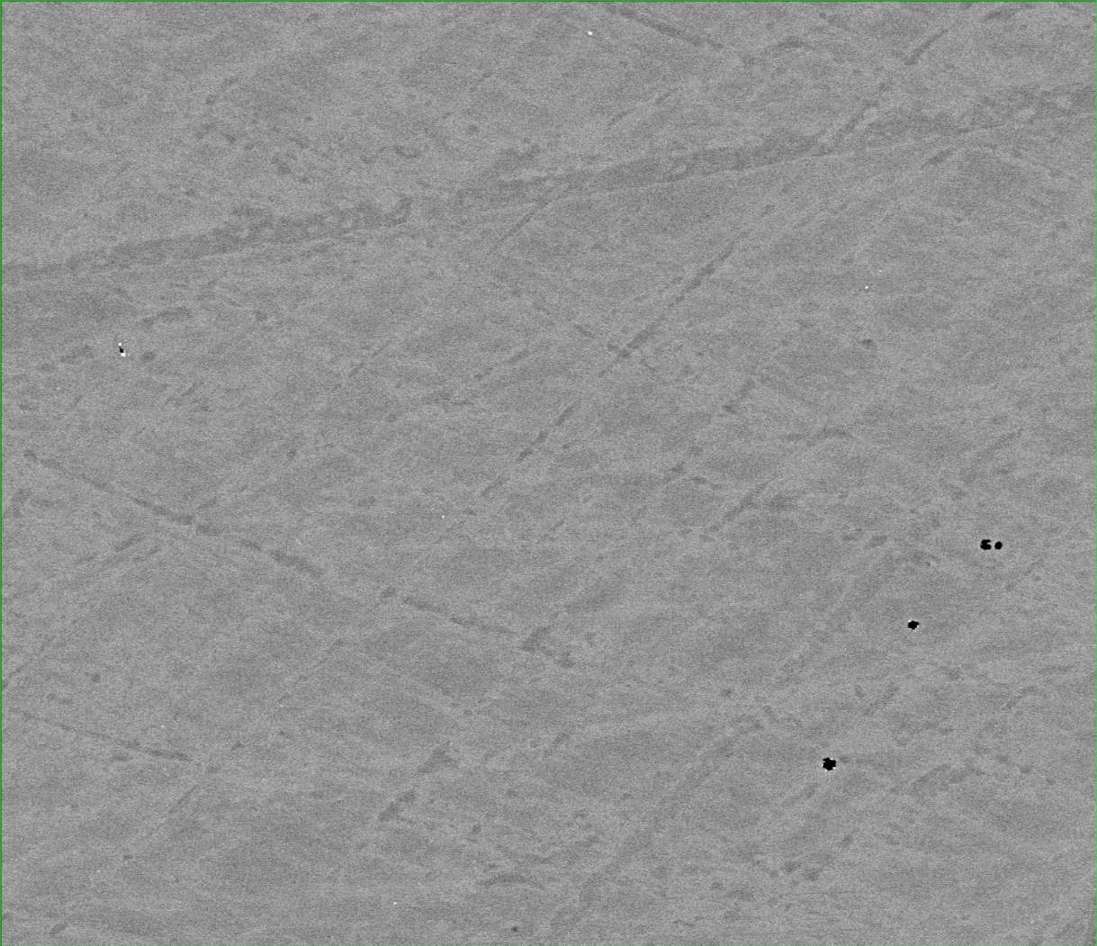
50 μm
Figure 2. LM2 Thermo-Calc simulation comparison to BSE image

Slide 3
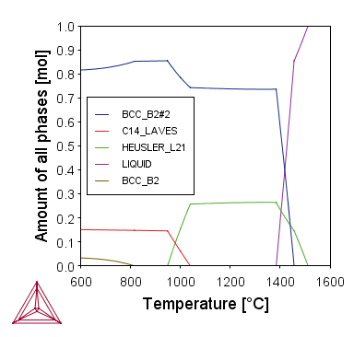
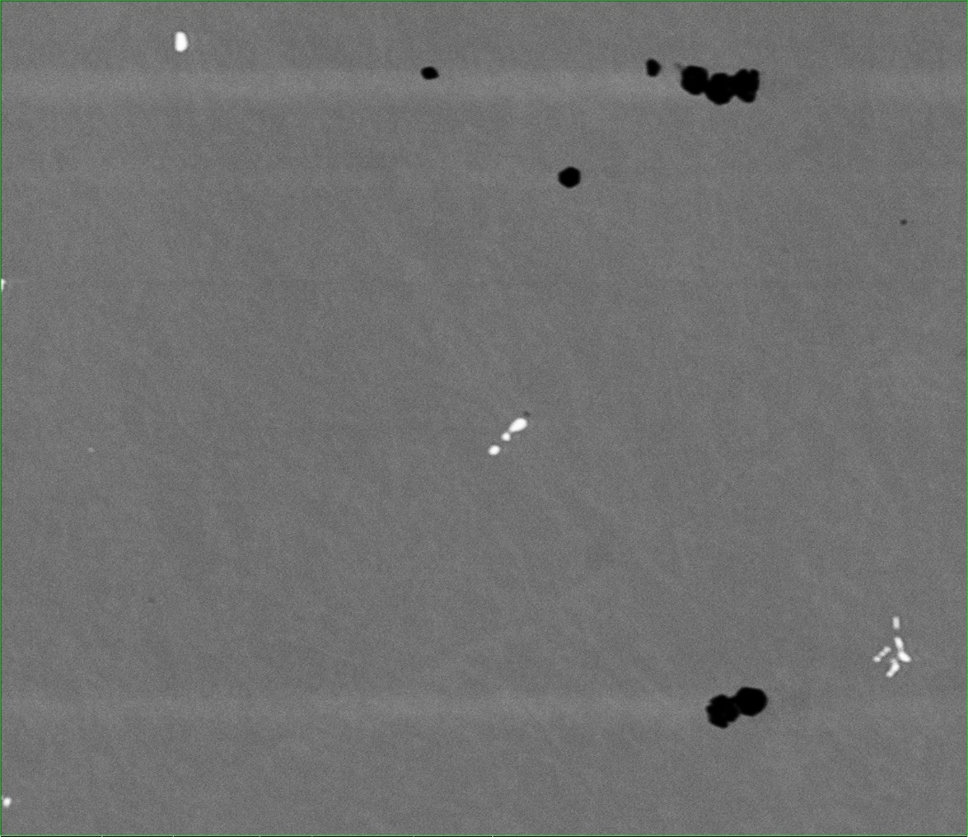
50 μm
Figure 3. LM3 Thermo-Calc simulation comparison to BSE image.
Table 2. LM3 Phase Compositions at 1200 °C
 | Phase | Al | Cr | Fe | Co | Ta
Thermo-Calc | BCC B2 | 29.3 | 13.6 | 13.6 | 43.2 | 0.3
 | Heus L21 | 31.8 | 0 | 0 | 50 | 18.2
EDX Measured | Bulk | 29.8 | 10.2 | 10.0 | 44.6 | 5.3
 | Particles | 0.0 | 3.7 | 1.9 | 13.2 | 81.2

Slide 4
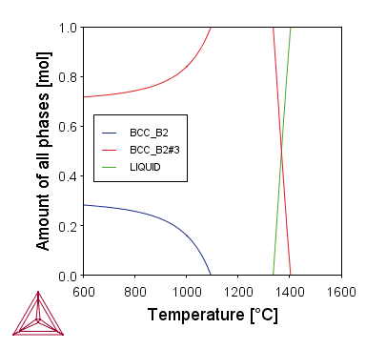
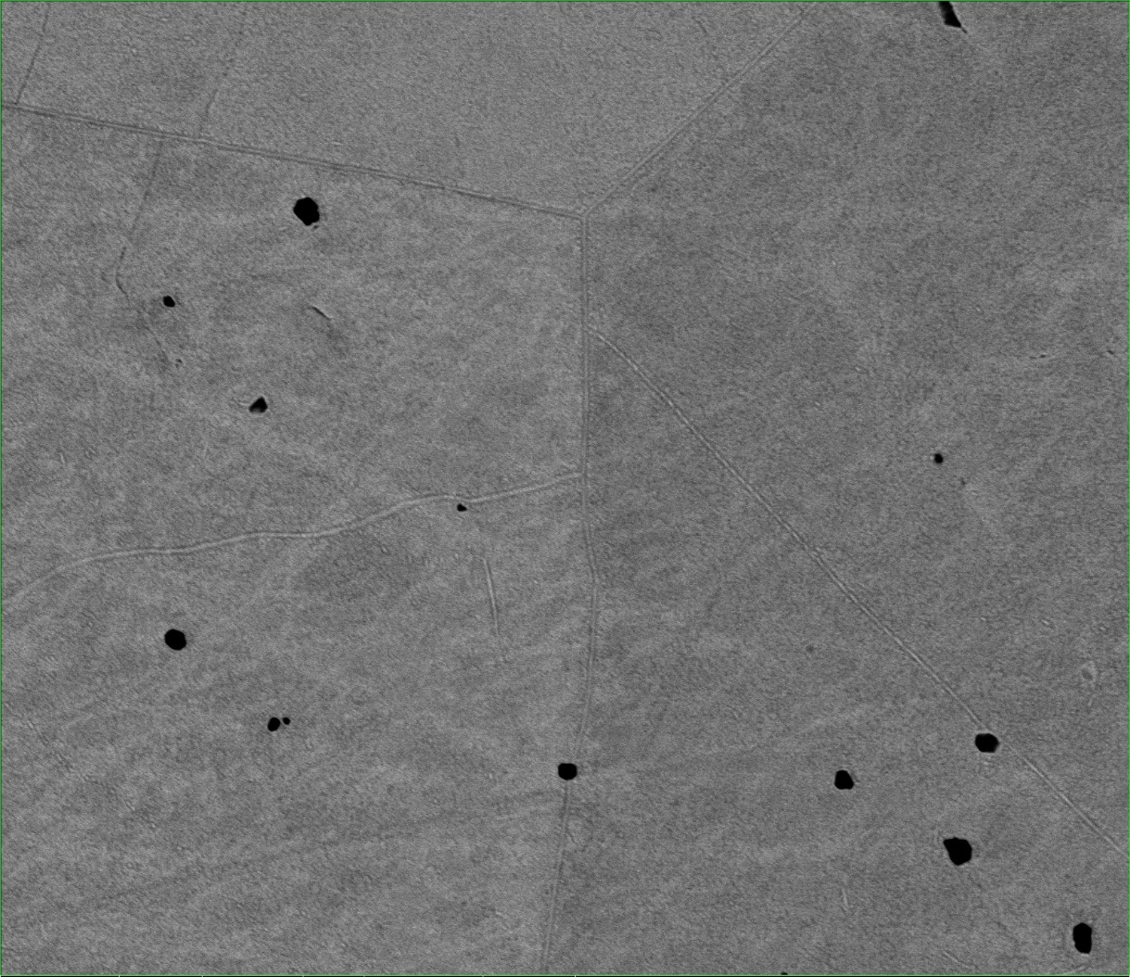
50 μm
Figure 4. LM4 Thermo-Calc simulation comparison to BSE image

Slide 5
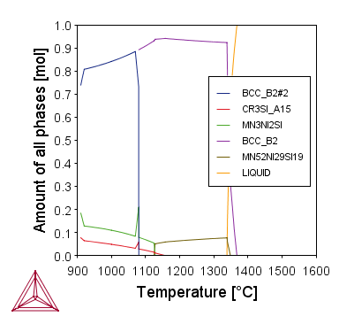
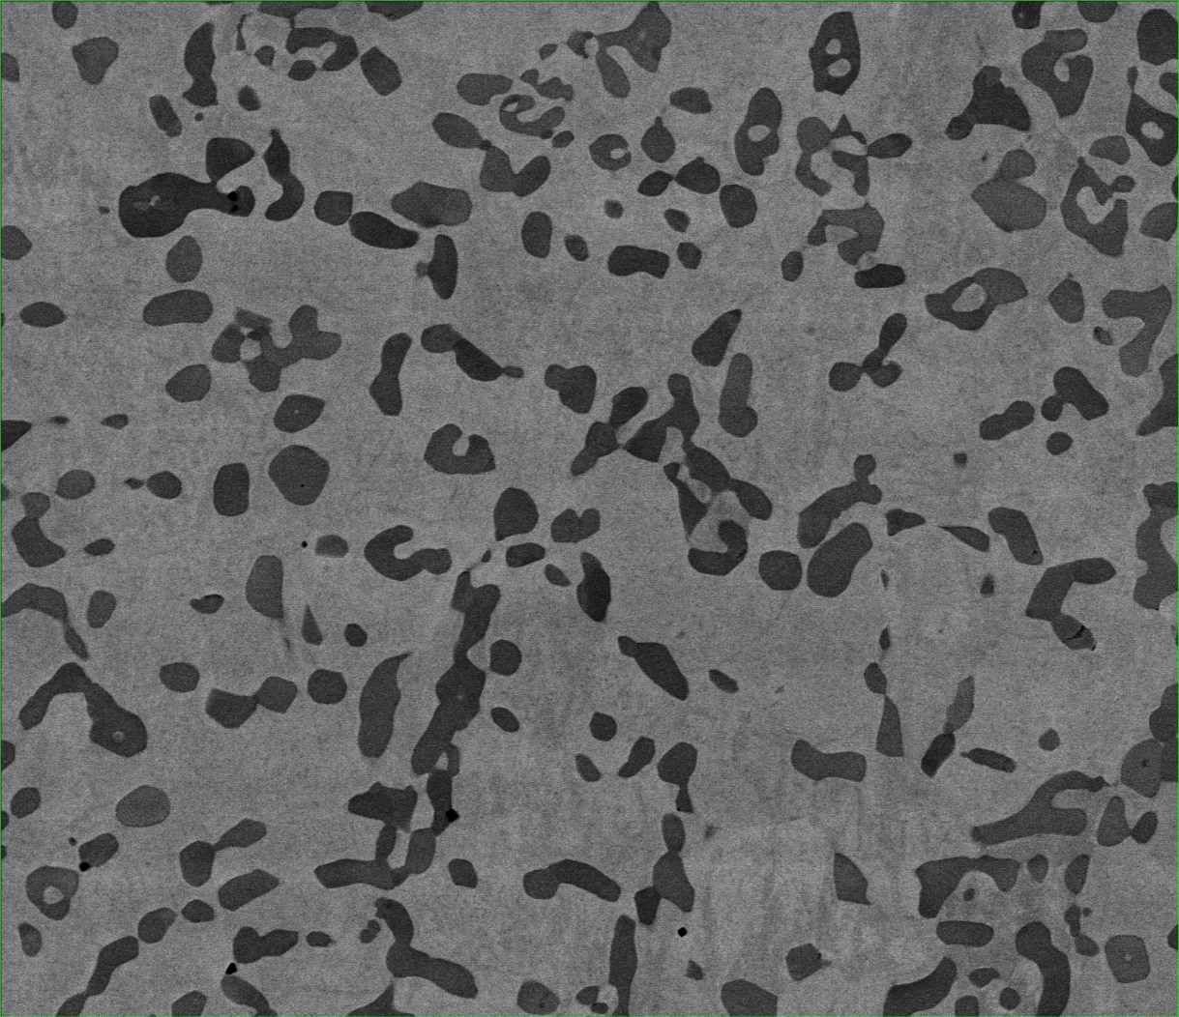
50 μm
Figure 5. LM5 Thermo-Calc simulation comparison to BSE image.
Table 3. LM5 Phase Compositions at 1200 °C
 | Phase | Al | Si | V | Mn | Ni
Thermo-Calc | BCC B2 | 27.1 | 3.8 | 16.3 | 22.7 | 30.1
 | MN52NI29SI19 | 0.0 | 19.0 | 0.0 | 52.0 | 29.0
EDX Measured | Bulk | 35.4 | 0.0 | 2.8 | 18.1 | 43.7
 | Particles | 0.9 | 23.1 | 54.3 | 19.8 | 1.9

Slide 6
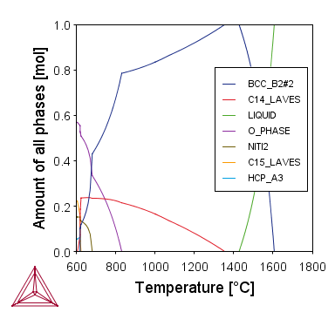
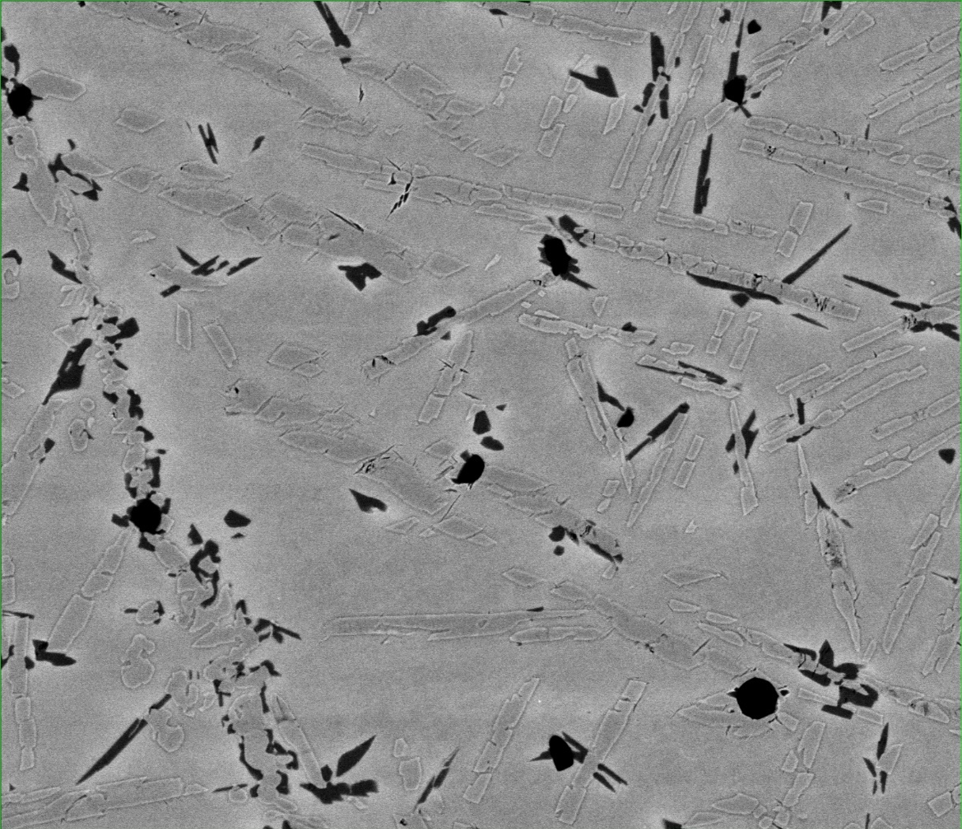
50 μm
Figure 7. HM1 Thermo-Calc simulation comparison to BSE image.
Table 4. HM1 Phase Compositions at 1200 °C
 | Phase | Al | Ti | Cr | Ni | Nb
Thermo-Calc | BCC B2 | 15.0 | 48.1 | 12.0 | 5.3 | 19.6
 | C14 Laves | 15.4 | 10.1 | 48.8 | 1.6 | 24.1
EDX Measured | Bulk | 15.2 | 49.5 | 10.8 | 2.7 | 21.7
 | Plates | 13.0 | 27.5 | 33.6 | 10.7 | 15.1

Slide 7
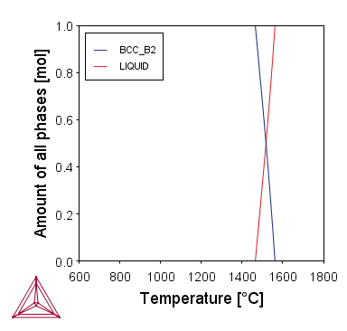
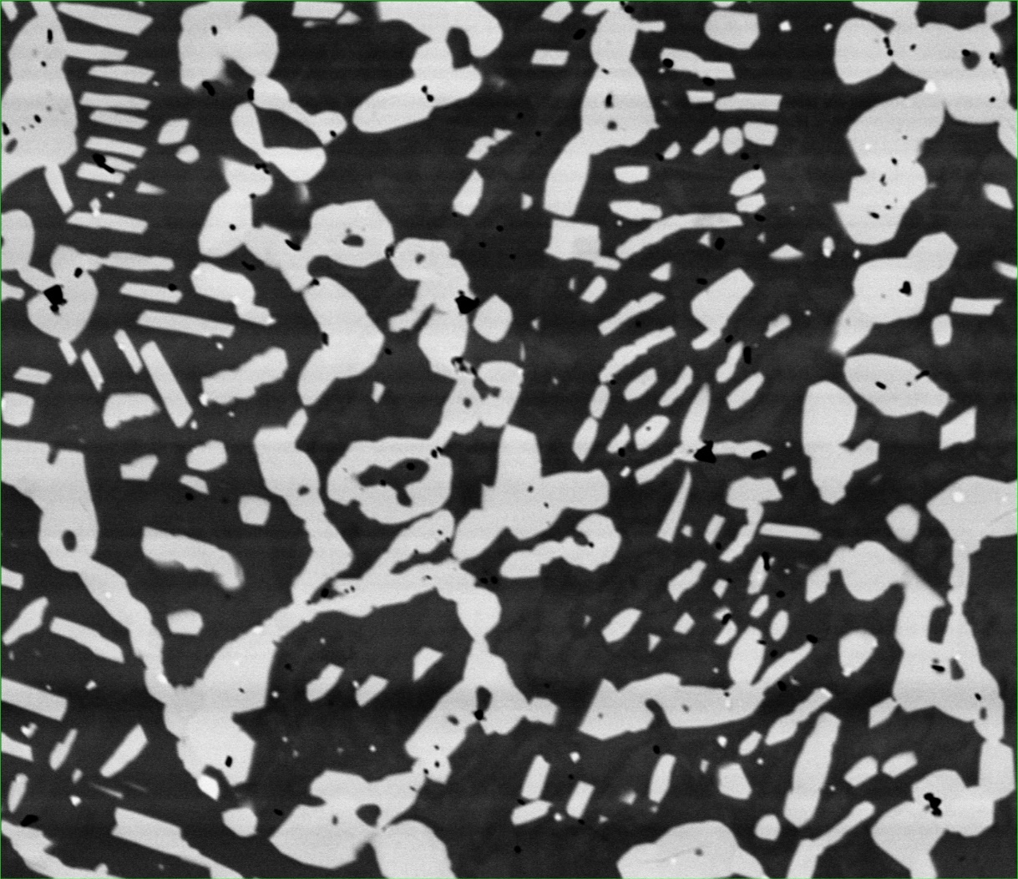
50 μm
Figure 8. HM2 Thermo-Calc simulation comparison to BSE image
Table 5. HM2 Phase Compositions at 1200 °C
 | Phase | Al | V | Mn | Fe | Nb
EDX Measured | Matrix | 33.1 | 35.1 | 21.0 | 9.9 | 0.9
 | Particle | 39.8 | 7.3 | 11.4 | 11.7 | 29.8

